Slide 1
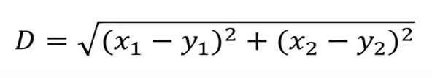
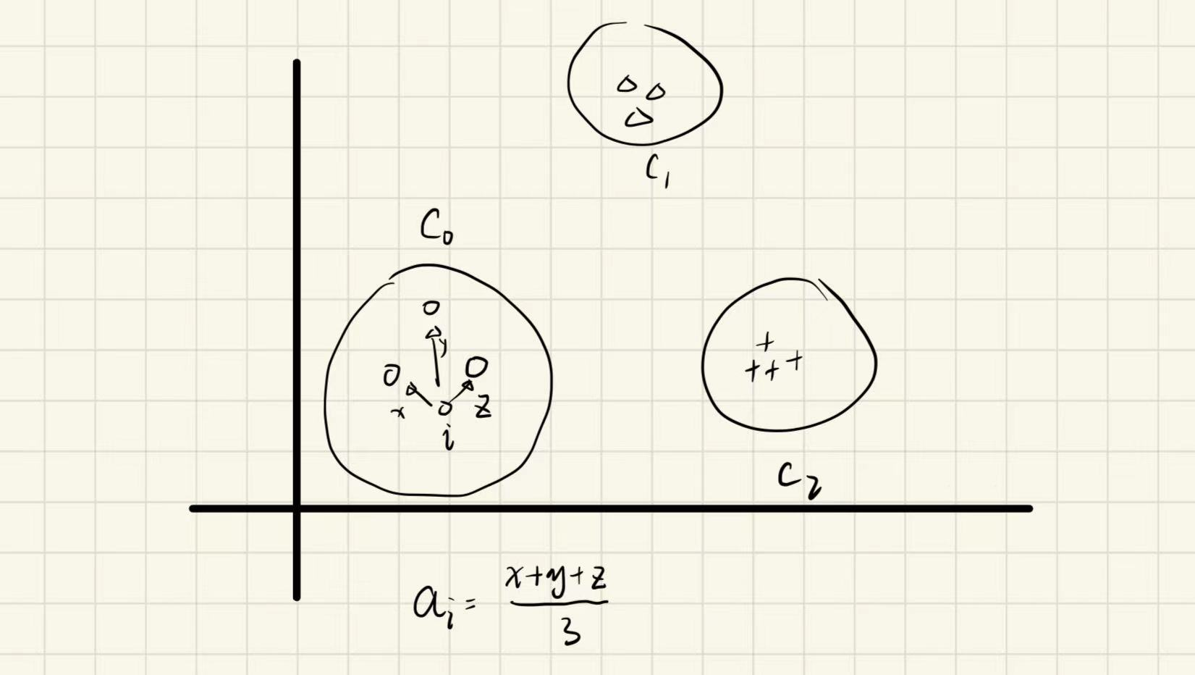
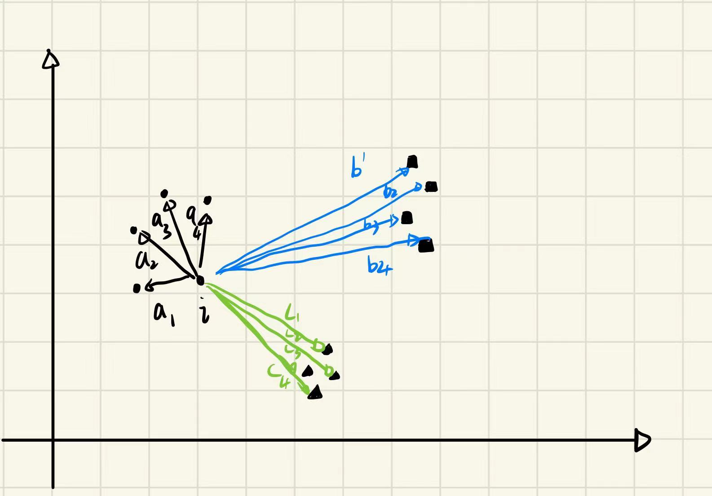
Silhouette Coefficient
The best value is 1 and the worst value is -1. Values close to 0 indicate overlapping clusters
Negative values usually indicate that samples have been assigned to the wrong clusters because different clusters are more similar
Between-cluster dissimilarity: average distance from sample i to all samples in other clusters(choose the small one)
Within-cluster dissimilarity: average distance from sample i to other samples in the same cluster

Slide 2
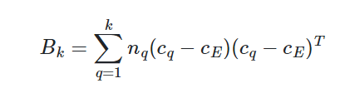
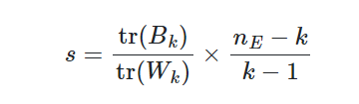


2. Calinski-Harabasz Index
Calinski-Harabasz Index（Variance Ratio Criterion） is a metric used to measure the performance of clustering algorithms, which is mainly based on the ratio between intra- and inter-cluster variance
Calinski-Harabasz metric measures the tightness within a class by calculating the sum of the squares of the distances between points in the class and the center of the class, and the separateness of the data set by calculating the sum of the squares of the distances between the centers of each class and the centers of the data set, and the CH metric is obtained by the ratio of separateness to tightness, thus, the larger the CH represents the more tightly packed the class is and the more dispersed the class is with the other classes, i.e., a better clustering Results (the larger the better)

Slide 3
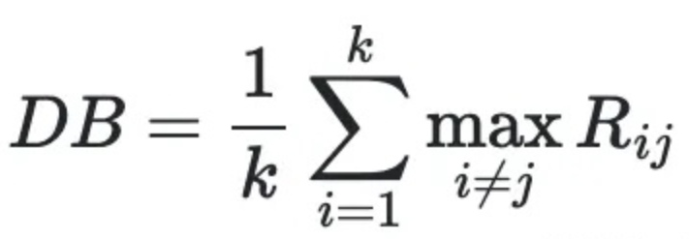

3. Davies-Bouldin Index (戴维斯-布尔丁指数)
Davies-Bouldin Index is mainly calculated based on the tightness within clusters and the separation between clusters.The value of Davies-Bouldin Index is in the range of, the smaller the value means better clustering resultsDB calculates the sum of the mean distance (CP) of the intraclass distances of any two classes divided by the distance between the two cluster centers to find the maximum value. smaller DB means smaller intraclass distances and larger interclass distances (the smaller the better).

Slide 4
Summary:
Silhouette Score: a measure of the similarity of each sample point in a clustering result to its own cluster and to other clusters
Calinski-Harabasz Index: calculates the clustering performance based on the ratio between intra-cluster and inter-cluster variance.
Davies-Bouldin Index: calculates the clustering performance based on the closeness within clusters and the separation between clusters.

